Slide 1
Data Engineering
Project 3 Group 1
Notes:
-Dawn -

Slide 2
Group 1 Team
Bobbi Fletchall
Linda Jepkorir
Dawn Reynoso
Notes:
Dawn-

Slide 3
Objective
The project aims to simulate a real-life scenario for a data engineer, focusing on handling raw healthcare data and executing the ETL process (Extract, Transform, and Load).
Notes:
-Dawn

Slide 4
Colorectal Cancer is the second leading cause of Cancer Deaths in the U.S. approximately 150,00 people will be diagnosed this year.
Data Background
Notes:
Dawn

Slide 5
Outline
01
04
02
05
06
03
Data Extraction
Data Load
Data Analysis
Data Output
Data Transformation
Data Challenges & Findings
06
03
Notes:
Dawn

Slide 6
Data Sources
Kaggle: https://www.kaggle.com/datasets/amandam1/colorectal-cancer-patients?resource=download
https://www.kaggle.com/datasets/omkarm0542/cancer-disease-prediction
Figshare: https://figshare.com/search?q=%3Acategory%3A%20%22Cancer%20Diagnosis%22&itemTypes=3
Notes:
Dawn

Slide 7
Data Extraction
Notes:
Dawn

Slide 8
Data Extraction
Data extraction is the foundational step in our project, involving the retrieval of datasets from various sources.
Using thorough web research, we identified the scope of our project and determined the appropriate method for extracting datasets.
All our datasets were available for download in CSV format.
Notes:
Dawn

Slide 9
Data Analysis
Notes:
Bobbi

Slide 10
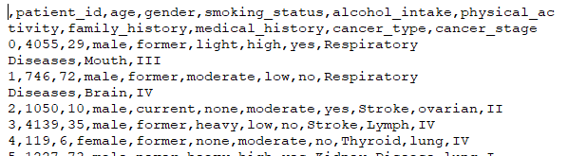
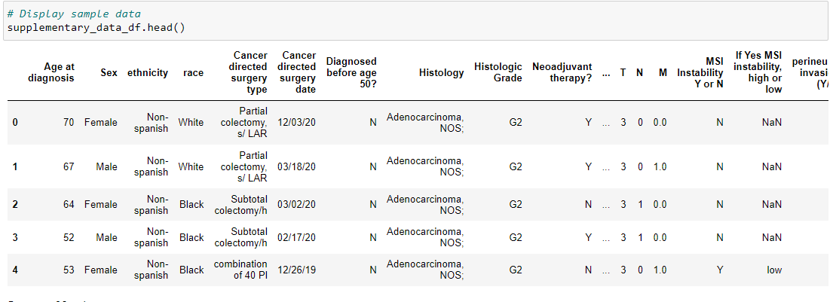
Data Analysis
During the data analysis phase, a thorough examination of each dataset file to understand its components and structure.
Reviewed column headers to ensure consistency in naming conventions.
Importing data into the data frame for initial exploration and examination.

Slide 11
Data Analysis
Initial data exploration to understand data distribution and characteristics.
Identification of any anomalies or inconsistencies in the data.
Utilization of tools such as Jupyter Notebook and Python for initial data inspection and exploration.
Notes:
-

Slide 12
Data Transformation
Notes:
`

Slide 13
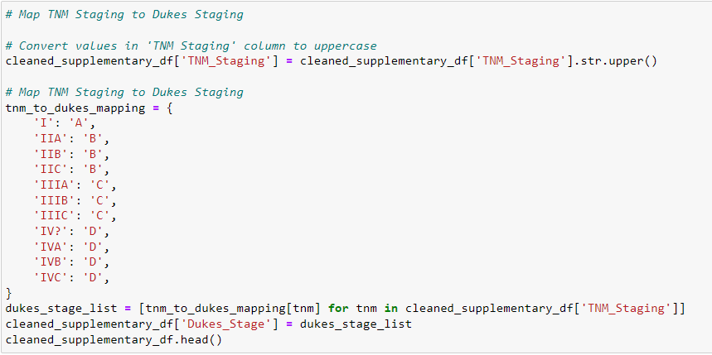
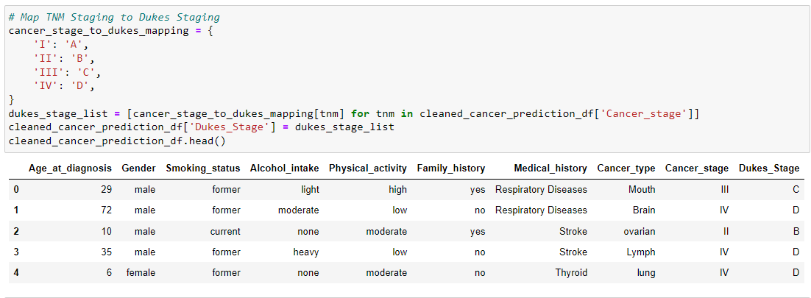
Data Transformation
Data transformation is a critical phase where we prepare the extracted data for further analysis and loading
We filtered the data to extract necessary columns across all three datasets and renamed columns to adhere to best practices naming conventions.
Investigation of potential data mappings was conducted to ensure consistency between different data tables, such as TMN staging and Duke Staging.
Notes:
Bobbi

Slide 14
Duke Staging & TNM Meaning
Duke Stages &
Meaning
Cancer Stage
TNM
Dukes A: invasion into but not through the bowel wall (90% 5-year survival)
Dukes B: invasion through the bowel wall but not involving lymph notes(70% 5-year survival)
Dukes C: involvement of lymph nodes (30% 5-year survival)
Dukes D: widespread metastases
The Stage of cancer describes the size of the tumor and how far it has spread from where it originated.
Stage 0 = The cancer is where it started (in situ) and hasn’t spread
Stage 2 = The cancer has grown but hasn’t spread
Stage 3 = The cancer is larger and may have spread to the surrounding tissues and /or lymph notes (or “glands), part of the immune system
Stage 4 = cancer has spread from where it started to lease 1 other body organ, also known as “secondary” or “metastatic” cancer.
T = Tumor Size
The size of the tumor with the numbers 1-4
1 for small, 4 for larger
N = Lymph Nodes
Numbers 0-3
0 means no lymph nodes have cancer, 3 means many do
M = Metastases
Whether the cancer has spread to another part of the body, numbers 0-1
0= no spread
1 = It has spread
Notes:
Bobbi

Slide 15
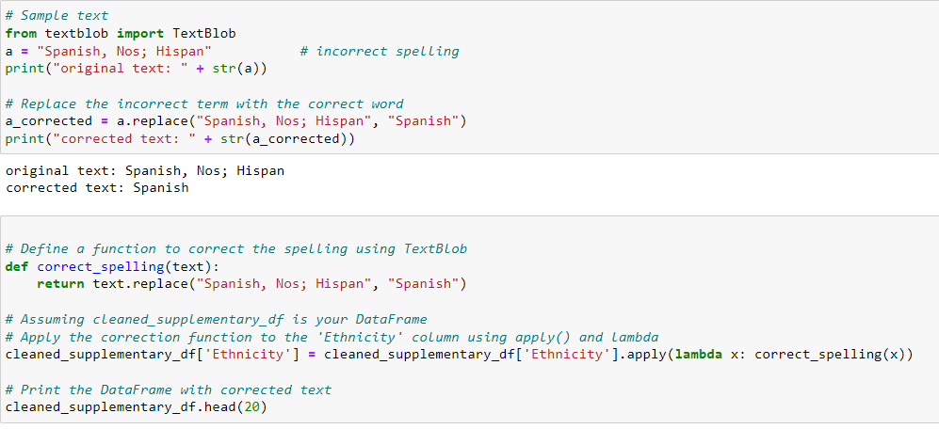
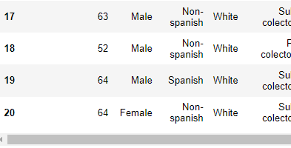
Data Transformation
Tools like TextBlob were employed to standardize specific column data entries, addressing variations and ensuring data uniformity
(pip install textblob)
Each cleaned version of the data frames was saved into CSV files for future use.
Notes:
Bobbi

Slide 16
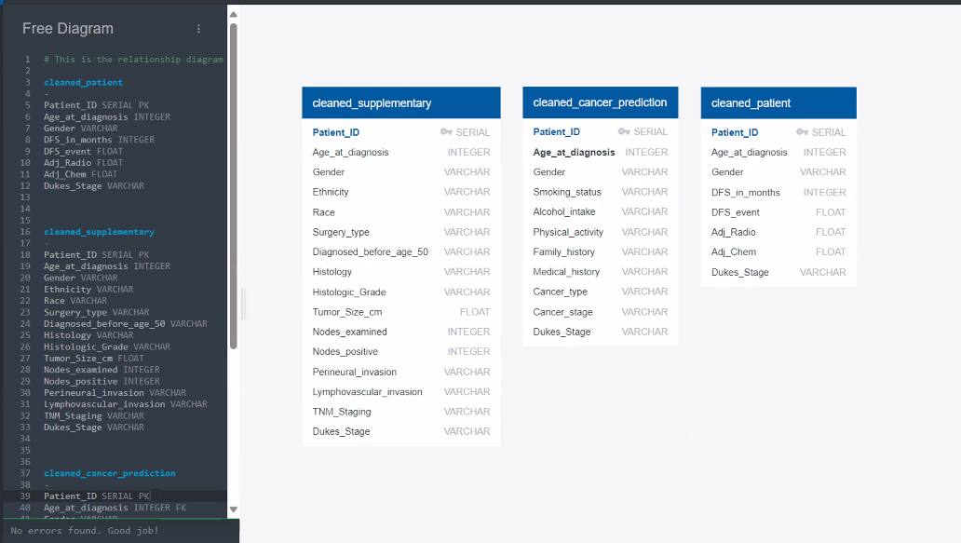
Data Tranformation
We developed an Entity-Relationship Diagram (ERD) to visualize data relationships and ensure database integrity.
Notes:
Bobbi

Slide 17
Data Load
Notes:
Linda

Slide 18
Data Load
The data loading process involved creating an Entity-Relationship Diagram (ERD) for tables to ensure alignment with naming conventions and verify primary keys.
NoSQL and MongoDB could have been used for the non-relation data.
We chose Postgres as the database platform due to its familiarity and ease of use in creating a database and uploading the CSV files into respective tables.
Notes:
Linda

Slide 19
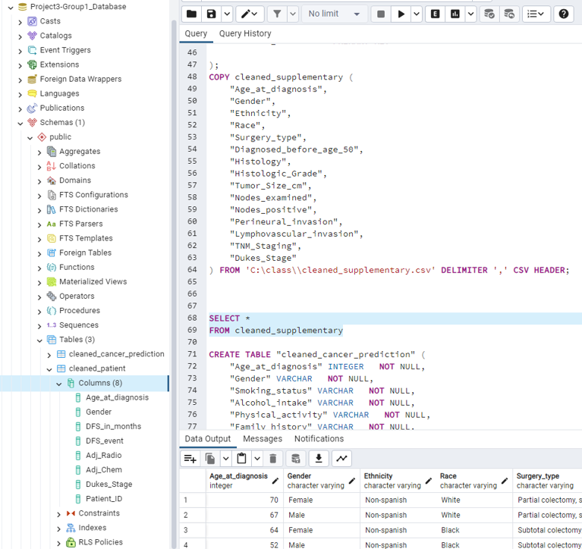
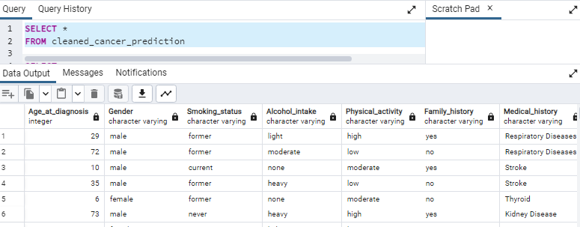
Data Load
Creating a database and uploading the CVS files into their respective tables.
A SQL query was created to verify table and column alignment with the input files.
Notes:
Linda

Slide 20
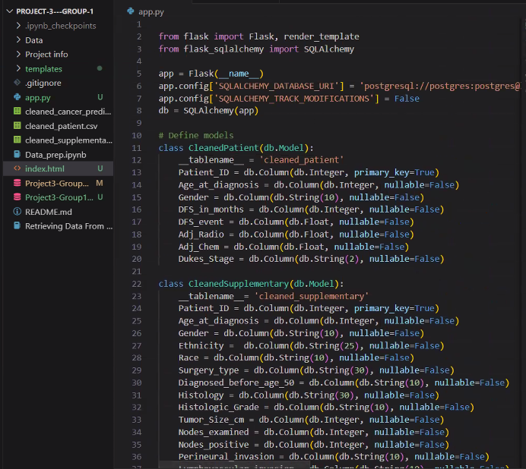
Data Load
Flask and Flask-SQLAlchemy were utilized to retrieve data from the database and load it onto an application using HTML.
Steps to use Flask-SQLAlchemy to link to the database.
Imported the necessary Modules.
Initializing the Flask Application
Configuring the Database
Initializing the Database
Defining the Database Models
Defining the Routes
Rendering the HTML template
Notes:
Some crucial steps were taken to establish the code:
Imported the necessary Modules: We imported the necessary modules such as Flask, render_template for rendering HTML templates, and SQLAlchemy.
Initializing the Flask Application: The Flask application was initialized as taught in class.
Configuring the Database: The database configuration involved specifying the URI for the PostgreSQL database. In our code, the URI would be the local PostgreSQL database as our database name.
Additionally, we ensured to disable the SQLAlchemy modification tracking features to suppress warnings.
By setting SQLALCHEMY_TRACK_MODIFICATIONS to False, we informed SQLAlchemy not to track modifications to objects, which are attributes or properties of objects within the SQLAlchemy session.
Per the site “This warning encourages developers to disable modification tracking, it’s not required for their application, thus avoiding potential performance issues and unnecessary warnings.
Initializing the Database: Since we now have gotten our configuration done, we use the SQLAlchemy object to define our database models. A model represents the structure of a database table. By setting our code up with classes we can query data from the database and perform database tasks within the Flask application.
Defining the Database Models application: Now that our Models are set up with classes. The classes will gain all the attributes and methods in the db.Model Class. These attributes and methods are needed to help define the database columns, relationships, and other items provided with the help of the SQLAchemy.
Defining the Routes: The @app.rout(‘/’) Provides a function that will handle requests to the root URL or in this case the main page of the webpage.
The def index() defines a function named index. This function handles requests to the root URL.
Inside this function – our code is asking for fetching data from each of our tables using the SQLAlchem by query.all() method.
So, when someone visits our webpage, the index function retrieves data from each of the tables in the database using the SQLAclhemy query all method. In return, this data then can be used for a web page or even an end user’s response.
Rendering the HTML template: In our code, it is generating the HTML content based on the data and template. When the webserver receives the request for the webpage, it will assemble the HTML content, and then return to the web browser to display it.

Slide 21
Flask-SQLAlchemy
Flask-SQLAlchemy is an extension for Flask that adds support for SQLAlchemy to Flask
applications.
It simplifies the integration of SQLAlchemy with Flask by providing helper functions and
patterns specifically tailored for Flask applications.
Flask-SQLAlchemy simplifies database setup, configuration, and management within Flask
applications.
It provides Flask-specific features like request-scoped sessions and automatic teardowns.
Flask-SQLAlchemy makes it easier to define models and interact with databases within a
Flask application context.
In summary, SQLAlchemy is a standalone library for database access and ORM, while Flask-
SQLAlchemy is an extension for Flask that integrates SQLAlchemy into Flask applications,
providing Flask-specific features and simplifying database operations within the Flask framework.
If you are developing a Flask application and need database support, Flask-SQLAlchemy is typically
the preferred choice as it streamlines the integration process and offers Flask-specific
features.
Notes:
As mentioned earlier in the presentation Flask and Flask-SQLAlchemy were utilized to help retrieve data from the database and load it on the application using HTML.
To understand and appreciate how Flask-SQLAlchemy works. We wanted to tell a little bit about how it works.
Flask-SQLAlchemy is an extension of Flask that helps aid support for SQLAlchemy to Flask Applications.
It simplifies the process of integrating SQL Alchemy with Flask applications, by offering helper tasks or functions specifically tailored for the Flask application.
These functions help us by streamlining the database-related tasks and focusing on building duties rather than dealing with little database confirmation details.
It also helps by streamlining the setup, Configuration, and management of databases in conjunction with the Flask application.
Side note these take database connections, specifying database models, and help with database migrations.

Slide 22
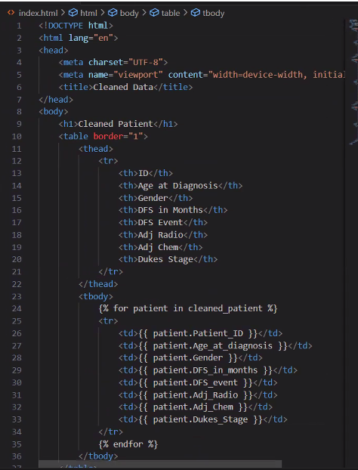
Data Load
The HTML file is a template used to deliver the data retrieved from the Flask application
Using the Basic HTML template format:
The document type was declared.
HTML Structure
Head Section
Body Section
Data Tables
Data Display placeholders
.
Notes:
The HTML file is a template used to deliver of the data retrieved from the Flask application
Using the Basic HTML template format:
The document type was declared: We declared the document type and version of HTML used.
HTML Structure: Using the root element of the HTML documents, specifying the language as English. It also Organizes content within the HTML document, including the head and body sections.
Head Section: Contains metadata such as character encoding and viewport settings, ensuring proper interpretation and display of content.
Head contains metadata information about the document .. This information includes character encoding and viewpoint settings.
Body Section: Holds the visible content of the webpage, including structured data tables for presentation. The body contains the visible content of the HTML documents.
This section contains the 3 sections by naming the database tables.
Data Tables: Utilized to organize and present data in a tabular format, enhancing readability and accessibility.
Each section contains information about the table things like.
Defines Table header rows,
Defines the table header cells
Defines the table body rows
Defines table rows
Defines table data cell.
Data Display placeholders: Employs template placeholders within HTML tables to dynamically populate content, enabling seamless integration with backend data sources.
Within each table data is displayed using template placeholders that respond to the attribute of the database models
In short this HTML template structures the data fetched from the Flask application into organized tables for display on a web page.

Slide 23
Data Output
Notes:
Linda

Slide 24
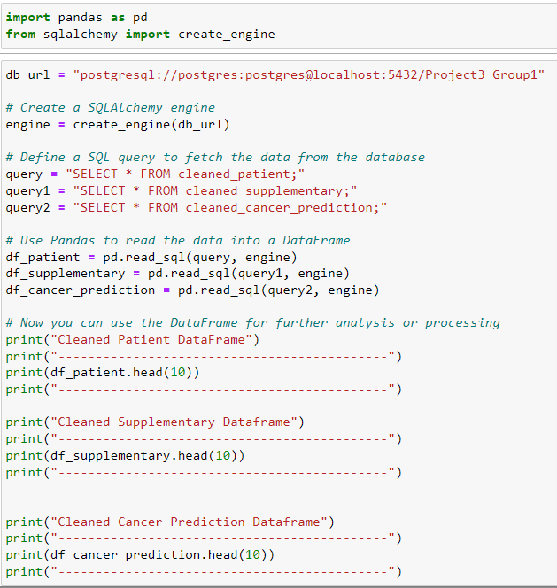
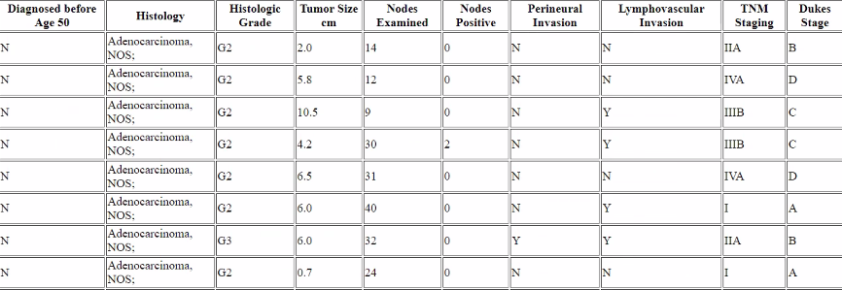
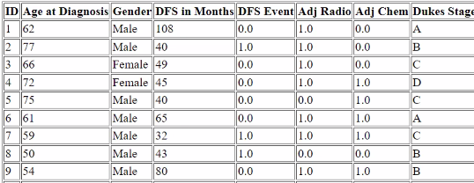
Data Output
Data output to Panda Data Frame
Data output to the HTML table
Notes:
Linda

Slide 25
Data Challenges
Notes:
Dawn

Slide 26
Data Challenges
During the project, we encountered several data challenges that required careful resolution.
One challenge was the lack of a primary key related to the healthcare dataset. To address this, a serial index was created as a primary key in Postgres during the loading process.
Another challenge arose when retrieving data using Flask-SQLAlchemy from Postgres. We learned the importance of maintaining proper file structure, such as creating a template folder with the HTML file to ensure proper functioning.
Notes:
One of the challenges we encountered during the data loading process was the absence of a primary key in each of the datasets.
This is a result of the stringent patient privacy regulations mandated by HIPAA laws, which prioritize the protection of sensitive patient information as an ethical consideration.
To overcome this obstacle, we implemented a serial index as a primary key within the PostgreSQL database.
This index uniquely identifies each row of data across all three tables, ensuring proper data management while adhering to HIPAA regulations.
Another challenge emerged during the data retrieval process using Flask-SQLAlchemy with PostgreSQL.
This highlighted the importance of maintaining a structured data file format. The issue arose when we overlooked the necessity of creating a template folder containing the HTML file.
Without this folder structure, our HTML code failed to function correctly, resulting in tables being displayed without any data.
By organizing our files appropriately and housing our index.html file within the template folder, we successfully resolved the issue, ensuring seamless data retrieval and display within our web application.
The other challenge the team had was finding datasets. The team found some great information in the form of an API. The problem we ran into was to gain access one of the sites had a request form with a 2-4 weeks turnaround if the permission was granted. The other site we found had a cost to the API.

Slide 27
Project Discoveries
Our project yielded valuable findings and insights that contributed to our understanding of the ETL process.
From an ETL perspective, it's crucial to determine the desired output and invest time in selecting the best tools for each project.
We learned the importance of having contingency plans when data output does not align with expectations, ensuring adaptability and resilience.
Notes:
Our project yielded valuable findings and insights that deepened our understanding of the ETL process.
From an ETL perspective, it's imperative to define the desired output and carefully select the most suitable tools for each project.
During our research, we realized that our data could have been compatible with either a non-relational or relational database structure.
We learned firsthand the importance of having contingency plans in place when the data output doesn't align with our initial expectations, highlighting the necessity for adaptability and resilience.
Initially, we believed our project plan was on the right track, but upon further review with Cait, we recognized the need to rethink our entire approach.
Additionally, we had to acquire an extra dataset as the one we found didn't contain any relevant information that could complement the data we already had.
Upon conducting a thorough analysis and research, we discovered that we could align the TNM scores with Duke Stages through comparisons and conversions.
This process involved meticulously examining the criteria and characteristics of each staging system and identifying commonalities and correlations between them.
By leveraging our research and our understanding of both systems and employing our programming skills, we were able to develop a method for translating TMN scores into corresponding Duke Stages.
This integration not only streamlined our data engineering process but also provided a comprehensive framework for assessing and categorizing cancer stages across different classification systems.
Our approach not only improved the efficiency of our data interpretation but also enhanced the clarity and consistency of our findings, contributing to a more robust understanding of cancer progression and treatment outcomes within the domain of data engineering.

Slide 28
Project Discoveries
We revealed TextBlob saved us time updating discrepancies within the columns
We discovered the benefits of using Flask-SQLAlchemy, which integrates with Flask and Postgres SQL databases, providing a seamless data retrieval and loading process.
Ethical consideration of the data:
Ethnicity was limited to either Black, White, or Spanish or non-Spanish therefore
doesn’t represent the population as a whole
Data representing a diverse age group. Most data represented data over 50 years of
age and not necessarily younger age group which trends have shown alarmingly
getting colon cancer.
Notes:
We introduced two new libraries to enhance our project's functionality and efficiency.
One of these, TextBlob, and Flask-SQLAlchemy which we already talked about.
Some of the ethical considerations of the data sets were as follows:
The data lacked diversity in data in:
Ethnicity was limited to either black or white, or Spanish or non-Spanish and therefore we found that this does not represent the population as a whole
Data representing a diverse age group. Most of the data represented data over 50 years of age and not necessarily younger age groups which trends have shown are alarmingly getting colon cancer.
In response, to most of the data representing the over 50 years. In early in late 2021 to early 2022, the age guidelines for screening colonoscopies were revised and rarely any earlier unless you
had a very strong family history of colon cancer.
Before 2022, colonoscopy screening were recommended at the age of 50 years. Now screenings commence at age 45 for most individuals, with earlier screenings recommended for those with a family history of colon cancer (starting at age 40 if there's a first or second-degree relative affected).
Individuals experiencing symptoms may require screenings even earlier.
Given these new guideline changes, it's anticipated that significant shifts in the ages reflecting screening rates and colon cancer incidence among younger age groups will be seen.
However, the data may take several months to a couple of years to become evident.
This is likely the reason why we are not seeing a significant representation of individuals below the age of 50 in our datasets.
However, the American Gastroenterological Association (AGA) and several other healthcare organizations are already observing the impact of these changes. There are several articles highlighting emerging trends in colon cancer among the younger populations. This underscores the importance of proactive measures and revised screening protocols in addressing the evolving landscape of colorectal cancer.

Slide 29
Any Questions ???
Notes:
Any Questions

Slide 30
Thank You
Notes:
Thank You

Slide 31
Definition Table
Duke staging | Dukes A: invasion into but not through the bowel wall (90% 5- year survival) Dukes B: invasion through the bowel wall but not involving lymph nodes (70% 5-year survival) Dukes C: involvement of lymph nodes (30% 5-year survival) Dukes D: widespread metastases
Disease Free Survival (DFS) | DFS: Disease-free survival, months (survival without the disease returning)
MSI Instability stable | Microsatellite stability and microsatellite instability are the two opposite results of the same biomarker test. When microsatellite DNA segments are unchanged (not mutated) in your colorectal cancer, the tumor (tumor) cells are considered microsatellite stable (MSS).
TNM T = tumor size N = lymph determines if lymph notes are involved. M = metastases | T = describes the size of the tumor, with numbers 1 to 4 (1 for small, 4 for large) N = stands for lymph nodes, with numbers 0 to 3 (0 means no lymph nodes have cancer, 3 means many do) M = stands for metastases or whether cancer has spread to another part of the body, with numbers 0 or 1 (0 means it has not spread, 1 means it has)
Notes:
Definition Table

Slide 32
Definition Table Continued
TNM Staging | T = primary (main) tumor, which is where the cancer started. The tumor’s size, location, and whether it has grown into nearby areas can all be important. Doctors also check for other nearby tumors. The T category can be assigned a letter or a number: TX means there’s no information about the primary tumor, or it can’t be measured. T0 means there is no evidence of a primary tumor (it cannot be found). This means that the cancer cells are only growing in the layer of cells where they started, without growing into deeper layers. This may also be called in situ cancer or pre-cancer. A number after the T (such as T1, T2, T3, or T4) might describe the tumor size and/or amount of spread into nearby structures. The higher the T number, the larger the tumor and/or the more it has grown into nearby tissues. N = Lymph nodes near the primary tumor usually are checked to find out if cancer has spread into them. Lymph nodes are small, bean-shaped collections of immune cells. Many types of cancer often spread to nearby lymph nodes before they reach other parts of the body. The N category can be assigned a letter or a number: NX means there’s no information about the nearby lymph nodes, or they can’t be assessed. N0 means nearby lymph nodes do not contain cancer. A number after the N (such as N1, N2, or N3) might describe the size, location, and/or the number of nearby lymph nodes affected by cancer. The higher the N number, the greater the cancer spread to nearby lymph nodes. M: look at other parts of the body to see if the cancer has spread. Cancer spread to parts of the body far from the primary tumor is known as metastasis. The M category is assigned a number: M0 means that no distant cancer spread has been found. M1 means that the cancer has been found to have spread to distant organs or tissues.
Notes:
Definition Table cont.

